Slide 1
Lecture 02: Software Lifecycles
Prof. Matthew Hertz Davis 352/ 645-4736 mhertz@buffalo.edu

Slide 2
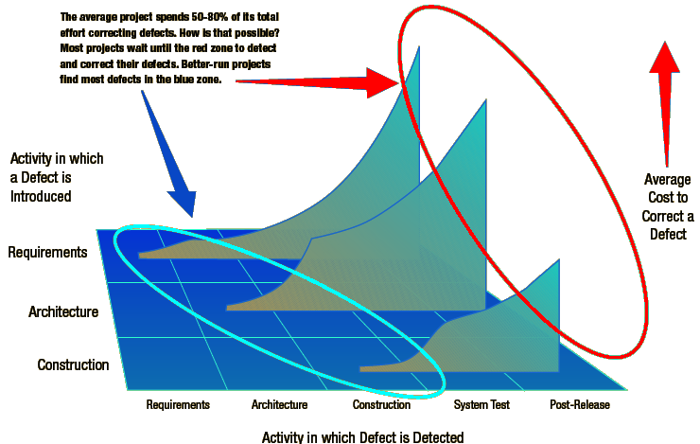
Why Lifecycle Matters

Slide 3
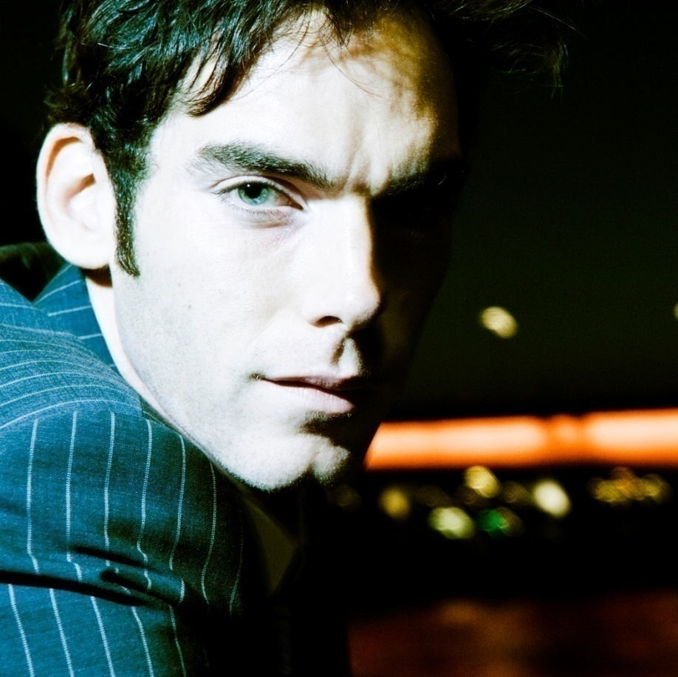

Why Do Models Matter?
Client has 2 programmers with different styles
Bob
Joe

Slide 4


Why Do Models Matter?
More about Bob & Joe…
Bob codes like Joe paid attention & like he did in college uses real lifecycle model

Slide 5
Why Do Models Matter?
Both look over notes handed by project executive
Bob then writes test cases then starts coding
Avoids wasting time & already has client's notes
Joe "restarts" by meeting with client to find needs
Adds entertainment & dining costs to get clients to show
%Complete | Bob |  | Joe
 | Work (in $) | Rework (in $) | Work (in $) | Rework (in $)
20% | $100,000 | $0 | $150,000 | $0
Total | $100,000 | $0 | $150,000 | $0

Slide 6
Why Do Models Matter?
Bob often duplicates code, but with minor tweaks
Requires expensive reworking & slows progress
Joe creates design minimizing code needed
Finds & fixes bugs in client’s requirements
%Complete | Bob |  | Joe
 | Work (in $) | Rework (in $) | Work (in $) | Rework (in $)
20% | $100,000 | $0 | $150,000 | $0
40% | $100,000 | $20,000 | $100,000 | $10,000
Total | $200,000 | $20,000 | $250,000 | $10,000

Slide 7
Why Do Models Matter?
Bob works from scratch & does not reuse code
Lacks plan to incorporate existing code
Joe expands design to outline algorithms
Simple process finds majority of errors
Merges classes & simplify design when possible
%Complete | Bob |  | Joe
 | Work (in $) | Rework (in $) | Work (in $) | Rework (in $)
20% | $100,000 | $0 | $150,000 | $0
40% | $100,000 | $20,000 | $100,000 | $10,000
60% | $100,000 | $20,000 | $100,000 | $10,000
Total | $300,000 | $40,000 | $350,000 | $20,000

Slide 8
Why Do Models Matter?
Bob’s code is project-specific & cannot be reused
Getting concerned as project starts falling behind
Joe writes detailed test cases for system
Simple to do since all details worked out
%Complete | Bob |  | Joe
 | Work (in $) | Rework (in $) | Work (in $) | Rework (in $)
20% | $100,000 | $0 | $150,000 | $0
40% | $100,000 | $20,000 | $100,000 | $10,000
60% | $100,000 | $20,000 | $100,000 | $10,000
80% | $100,000 | $20,000 | $100,000 | $10,000
Total | $400,000 | $60,000 | $450,000 | $30,000

Slide 9
Why Do Models Matter?
Bob cannot provide details to get extra help
Lots of all-nighters needed to complete system
Joe’s coding is easy with well-defined tests
Farm animals could be used for this step
%Complete | Bob |  | Joe
 | Work (in $) | Rework (in $) | Work (in $) | Rework (in $)
20% | $100,000 | $0 | $150,000 | $0
40% | $100,000 | $20,000 | $100,000 | $10,000
60% | $100,000 | $20,000 | $100,000 | $10,000
80% | $100,000 | $20,000 | $100,000 | $10,000
100% | $150,000 | $20,000 | $50,000 | $10,000
Total | $550,000 | $80,000 | $500,000 | $40,000

Slide 10

Why Do Models Matter?
Bob cannot provide details to get extra help
Lots of all-nighters needed to complete system
Joe’s coding is easy with well-defined tests
Farm animals could be used for this step
%Complete | Bob |  | Joe
 | Work (in $) | Rework (in $) | Work (in $) | Rework (in $)
20% | $100,000 | $0 | $150,000 | $0
40% | $100,000 | $20,000 | $100,000 | $10,000
60% | $100,000 | $20,000 | $100,000 | $10,000
80% | $100,000 | $20,000 | $100,000 | $10,000
100% | $150,000 | $20,000 | $50,000 | $10,000
Total | $550,000 | $80,000 | $500,000 | $40,000

Slide 11


What’s The End Result?
Bob barely finishes
Most goals are met
Crashes occasionlly
GUI not like contract
Joe is tanned & rested
Fully meets needs
Reliable & robust
GUI mostly correct

Slide 12


What’s The End Result?
Bob barely completes
Most goals are met
Crashes on occasion
GUI not as wanted
Joe is tanned & rested
Fully meets needs
Reliable & robust
GUI mostly correct
Client fires them both
Cared about ORIGINAL GUI

Slide 13
Models Matter
Client valued GUI design highly
Joe and Bob both chose inappropriate models
But Joe gets better chair in unemployment
Only successful life cycle models survive
Nobody records failures or the merely adequate
But remember, there is no silver bullet…
Strengths & weaknesses to each model
Important to match tool to situation
New models fix weaknesses in existing approaches

Slide 14
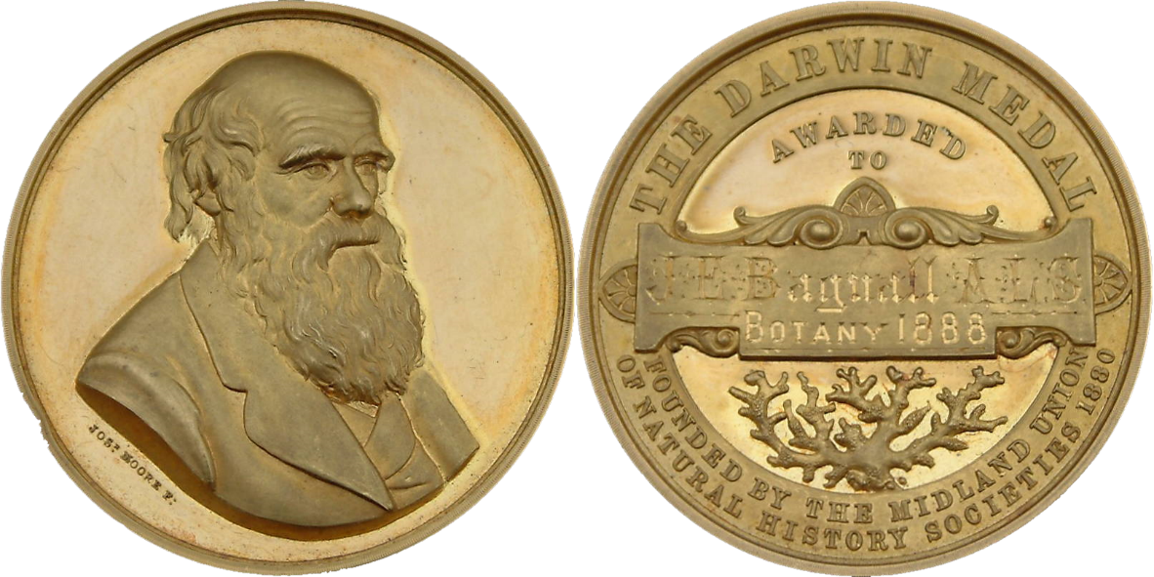
Models Matter

Slide 15

Classroom Development
Always start from scratch
Requirements perfect from start
Work that must be done is clear
Coding begins immediately at start
Projects are trivial jokes for real-world
Longest project last at most 2 months
Ends total mess; cannot reuse code
AI policy prevents reuse, so not a big deal

Slide 16
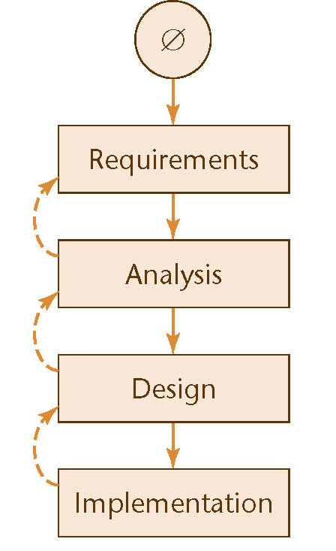
Waterfall Model
Original model of software lifecycle
Outlined steps that must happen
Project finished once shipped to client
Moves software to assembly line
Station-to-station travel of project
Model enables people to specializes
Set of deliverables created over step
Evidence & result of following process
Ends with baseline delivered to client
Contains complete set of documents

Slide 17
Waterfall Model
Original model of software lifecycle
Outlined steps that must happen
Project finished once shipped to client
Moves software to assembly line
Station-to-station travel of project
Model enables people to specializes
Set of deliverables created over step
Evidence & result of following process
Ends with baseline delivered to client
Contains complete set of documents
This means:
a) nobody likes it;
b) rarely works in real life; &
c) everybody tries improve it

Slide 18

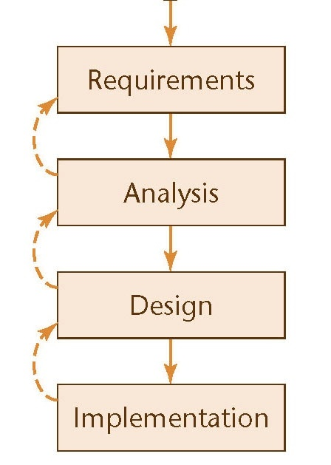
Waterfall Model
Assumes project begins as clean slate
Big Bang approach another name used
Bug fixes and maintenance not planned
Ends once coded; single pass approach
Especially now, reality rarely this clean

Slide 19

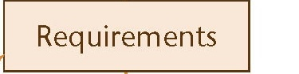
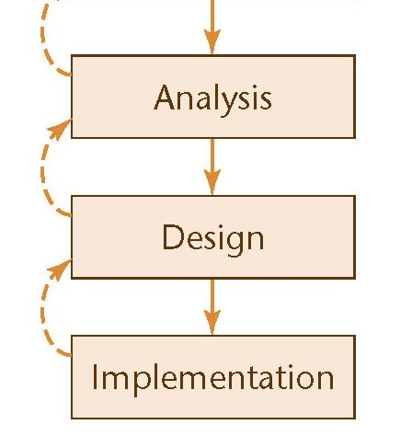
Waterfall Model
Requirements begins with meetings
Only chance for client to provide input
Working together to define project
Ends with contract specifying result
Once contract signed, client goes away
No further interaction until delivery

Slide 20
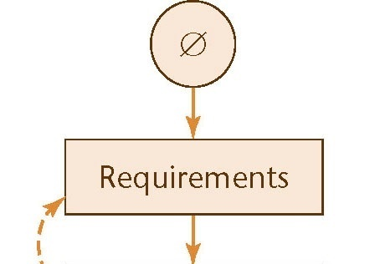

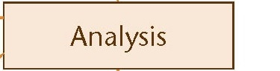
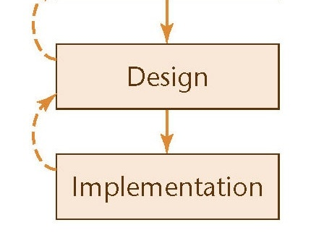
Waterfall Model
Requirements begins with meetings
Results specified in contract at end
Analysts use contract to develop ideas
Create models, schema, business logic
But starts with check of contract
Looking for inconsistencies or ambiguities
Very limited window to flag mistakes
Hands results to the project design team

Slide 21
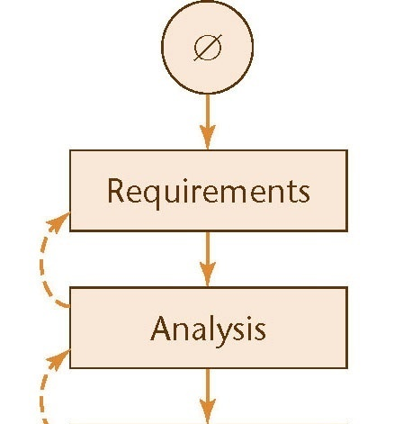
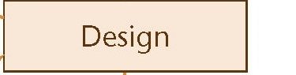
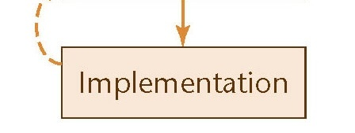
Waterfall Model
Analysts use contract to develop ideas
Create models, schema, business logic
Design outlines code to be written
Needs to specify classes & routines
Hardware & architectures also required
Has to fit existing models & schema
Algorithms often specified at this stage

Slide 22
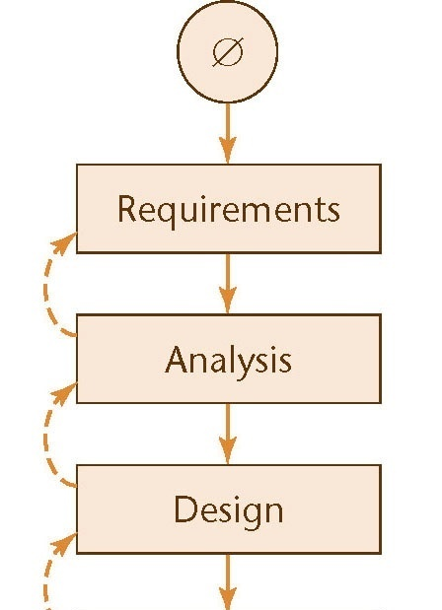
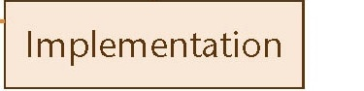
Waterfall Model
Design outlines code to be written
Needs to specify classes & routines
Implementation is for the coders
Start with time to find design problems
Then match design in code written
Only job is to match design given them
Client returns at end to take baseline

Slide 23
Waterfall Model
Extremely efficient WHEN it works
Revolutionary like Ford’s assembly line
Strengths used due to specialization
With all info, best decisions possible

Slide 24

Waterfall Model

Slide 25
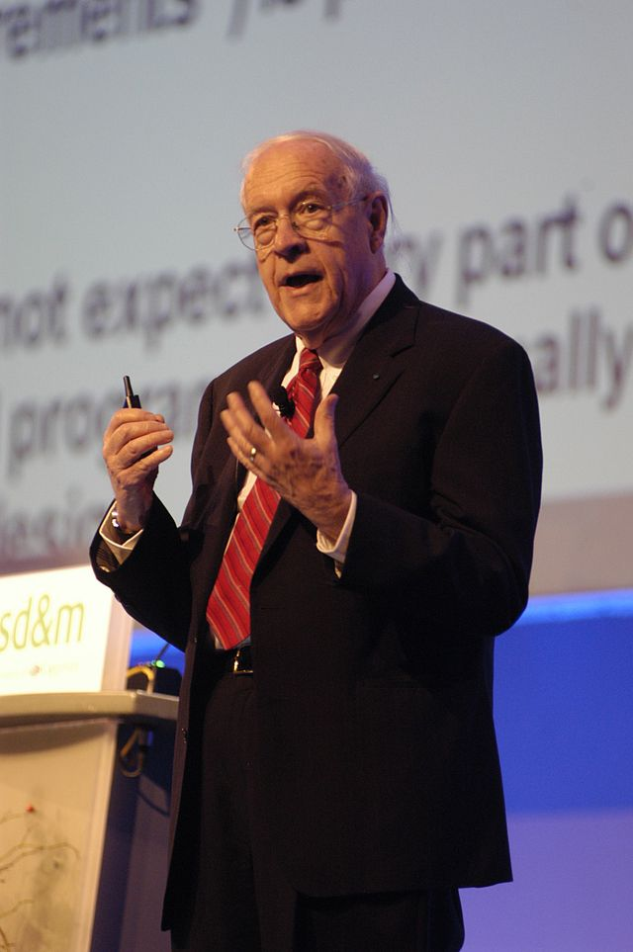
Waterfall Key Problem
Changeability is an essential difficulty with software
Waterfall assumes everything known at start
Fred Brooks

Slide 26
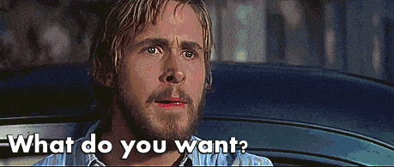
Talking To Clients

Slide 27
Waterfall Model
Useful when:
Client knows needs for their system
Needs can be fully documented & described
Little-to-no interaction sought while developed
Large organization can afford to specialists for each step
Maintenance & updates unimportant/not on the table

Slide 28
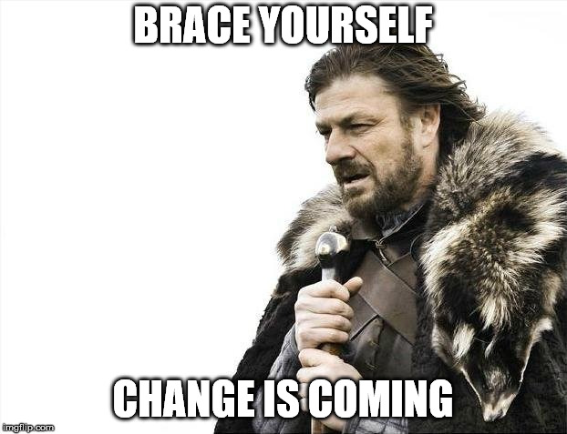
Moving Target Problem

Slide 29
Moving Target Problem
Changes always happen during a project
Ability to react and incorporate change important, but…
…disrupts flow & creates issues with completed work
Changes during process causes regression faults
Errors often in unrelated portion of project
These changes become major pain to fix
Restart eventually needed as fixes get more complex
Advertised as "overhauled engine" & "major speedup"

Slide 30
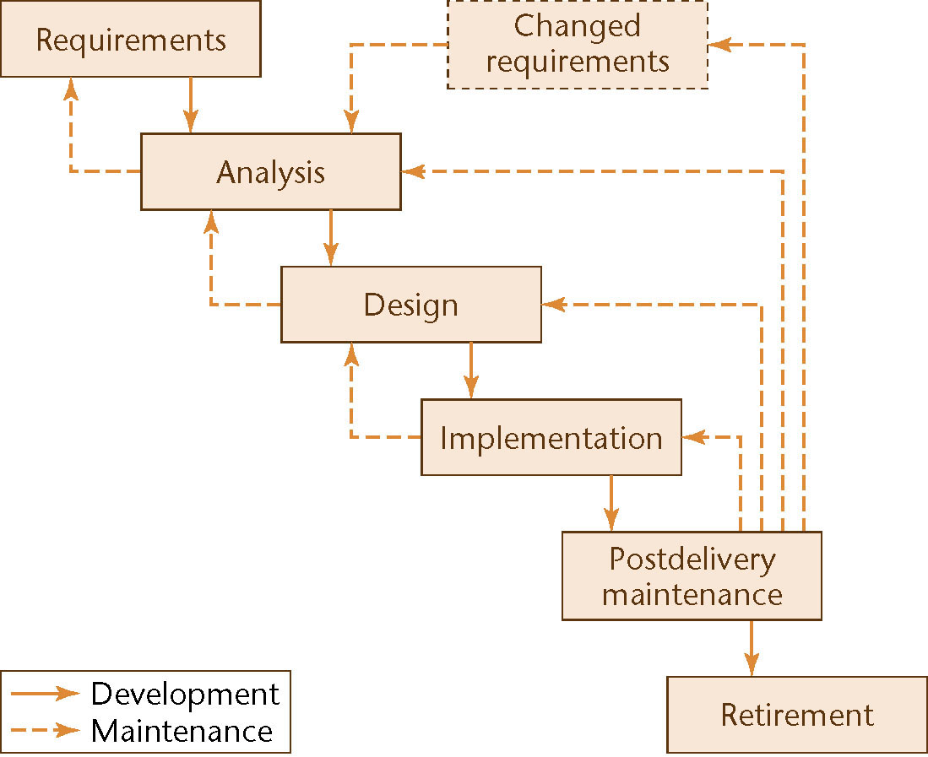
Rapid Prototyping
Create prototype after each step
to check requirements

Slide 31
Rapid Prototyping
Usability and looks are focus for rapid prototype
Provides limited ability for client to provide feedback
Functionality limited to basics (and often faked)
Any restarts take pieces back through full waterfall
Project feasibility unclear, since functionality left to end
Led to creation of VisualBasic & XCode's iOS setup
Lightweight tools emphasizing look-and-feel of app
Lousy languages with serious performance issues
Confusion possible when clients “see” finished product

Slide 32
Waterfall v Rapid Prototype
Notes:
Image of cascading waterfall used under a CC BY-NC 2.0 license. The original image was taken by Cameron Wears and is available at: https://www.flickr.com/photos/camwears/28598801471

Slide 33
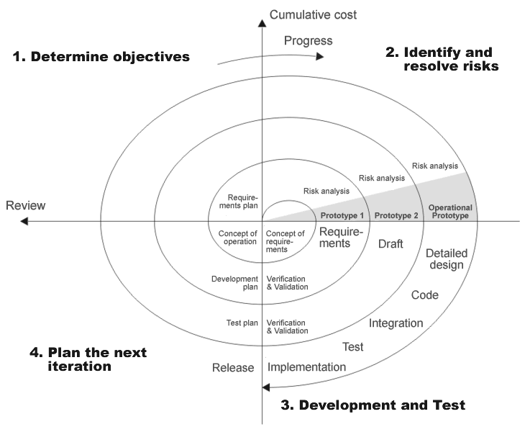
Spiral Lifecycle

Slide 34
Spiral Lifecycle
Useful for projects with unknown levels of risk
Functionality & feasibility key as opposed to looks
Uses waterfall ideas, but more cautious in execution
Each phase ends with estimate for client to review
If client like results and accepts risks, work continues
But okay to kill project when risks deemed too high
Very useful for exploratory or experimental work
Starts small and grows with time and confidence
Also can cause problems, since growth brings own risks

Slide 35
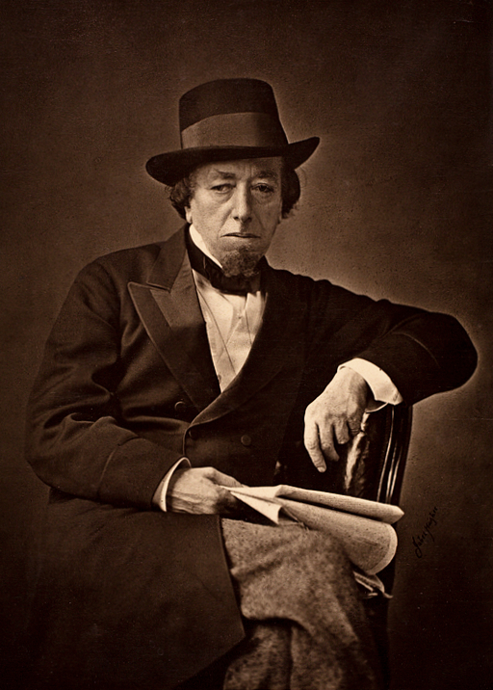
Changes
Change is inevitable
Change is constant
Benjamin Disraeli
Notes:
Image is in public domain. Original available at: https://upload.wikimedia.org/wikipedia/commons/0/0c/Benjamin_Disraeli_by_Cornelius_Jabez_Hughes%2C_1878.jpg

Slide 36
Rational Unified Process
Dominant traditional method of OO code creation
Methodology unifies work by “Three Amigos”
Not just a life cycle, really looks at all of software
Emphasis placed on making process rational
Coders need steps from the waterfall model
These steps are not what business cares about
Businesses are profit-making ventures only

Slide 37
Rational Unified Process
Dominant traditional method of OO code creation
Methodology unifies work by “Three Amigos”
Not just a life cycle, really looks at all of software
Emphasis placed on making process rational
Coders need steps from the waterfall model
These steps are not what business cares about
Businesses are profit-making ventures only
Code is NOT the goal!

Slide 38
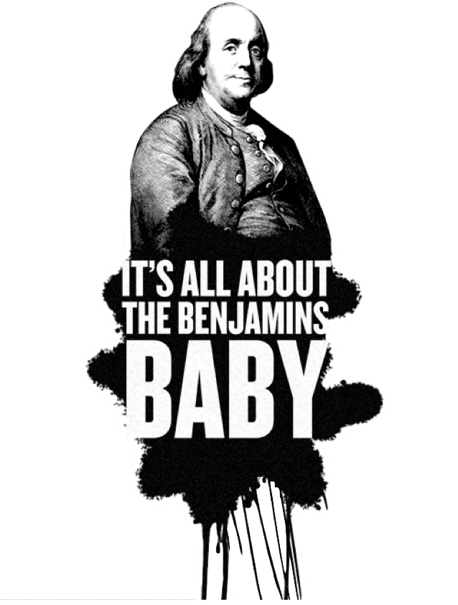
Code is NOT the Goal!

Slide 39

Code is NOT the Goal!
Notes:
Translate my joke (which is really a song from before they were born) from American to European

Slide 40

Code is NOT the Goal!
Notes:
$100 is currently worth €85.49

Slide 41
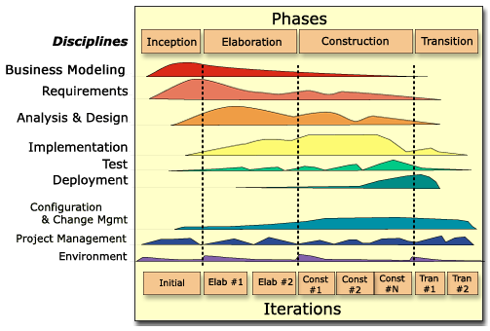
RUP

Slide 42
RUP
Time
Work

Slide 43
RUP
Time flows through 4 business phases
Work

Slide 44
RUP
Time flows through 4 business phases
follows waterfall
Work

Slide 45
Inception Phase
Determine if project should be undertaken
Can we complete project within acceptable timeline?
Does the business model make sense?
Possible risks are examined & evaluated
Risks can be technical, architectural, or engineering
Risk mitigation approaches are investigated
Learn options by implementing proofs-of-concept
Develop feel for environment during this time

Slide 46
Inception Phase
Determine if project should be undertaken
Can we complete project within acceptable timeline?
Does the business model make sense?
Possible risks are examined & evaluated
Risks can be technical, architectural, or engineering
Risk mitigation approaches are investigated
Learn options by implementing proofs-of-concept
Develop feel for environment during this time

Slide 47
Elaboration Phase
Refine work from inception phase
Requirements are clarified and expanded
Analysis performed in any detail
Create the design documents
Elaborates & enhances inception phase’s work
At end of phase, suits will disappear
Workload becomes domain of geeks after phase

Slide 48
Elaboration Phase
Refine work from inception phase
Requirements are clarified and expanded
Analysis performed in any detail
Create the design documents
Elaborates & enhances inception phase’s work
At end of phase, suits will disappear
Workload becomes domain of geeks after phase

Slide 49
Construction & Transition
Construction phase performed by the techies
Midpoint when α software is ready for viewing
Often larger release of β version at end
Transition phase moves software to clients
Results from β tests drive this phase
Ends with project release & start of maintenance

Slide 50
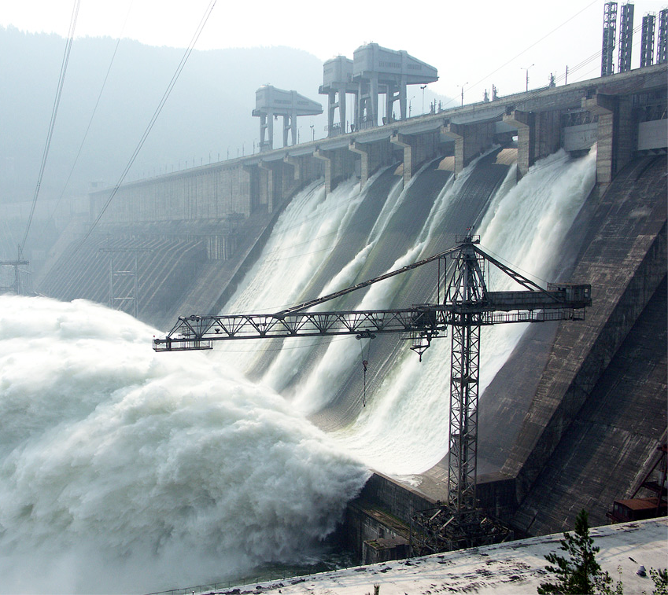
Waterfall vs. RUP

Slide 51
Iterative Development
Improves waterfall by working incrementally
Select most important piece needed at this moment
Follow complete waterfall to develop that ONE piece
Select new most important piece in new system
This approach also called stepwise refinement
Parallel development okay if multiple groups exist
Pieces integrated (merged) as each is completed
Quick reactions & less duplication goal of approach
But can increase costs: more regression testing needed

Slide 52
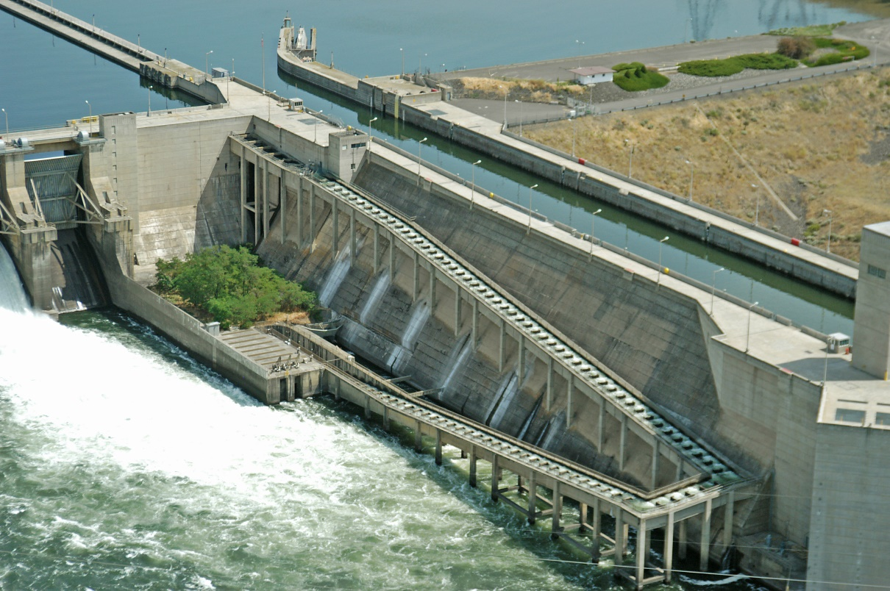
Waterfall vs. Iterative
Notes:
Salmon Ladder picture used under Creative Commons Attributions License by salmonrecovery. Original available at: https://www.flickr.com/photos/60161247@N03/11954495315/sizes/o/

Slide 53
Agile Methods
Grows out of iterative development processes
Assumes that the changes inevitable & unpredictable
Planning irrational: only immediate future knowable
Series of short sprints replaces entire waterfall model
Think about the project & select most important tasks
Write acceptance tests to know when tasks complete
Do just enough coding to pass tests (& unit tests)
Design emerges by as code adjusted (refactored)

Slide 54
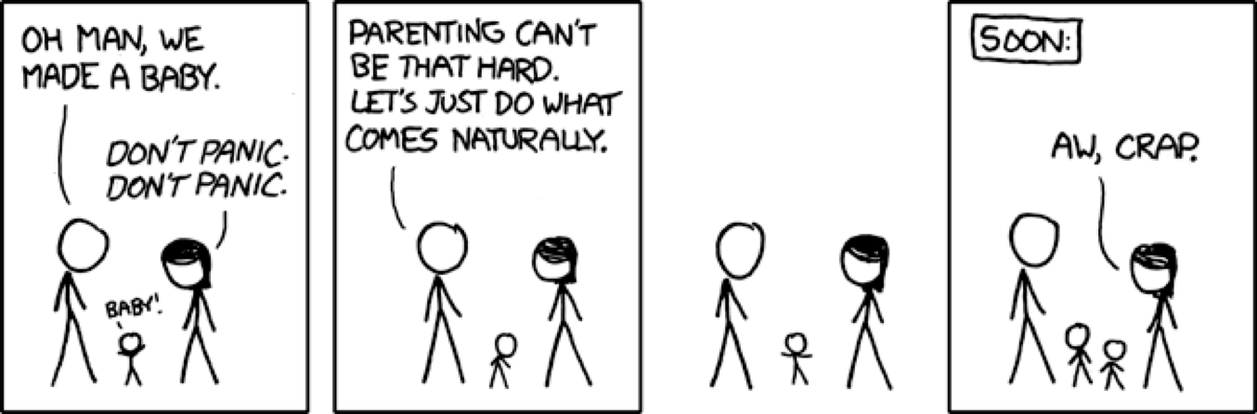
Agile Development
Not engineers, but coders: do what comes naturally

Slide 55
Agile Development
Not engineers, but coders: do what comes naturally
Other options too difficult, so let’s give up entirely!
Not always the best idea, but since we sucked before…

Slide 56
Agile Development
Not engineers, but coders: do what comes naturally
Other options too difficult, so let’s give up entirely!
Not always the best idea, but since we sucked before…

Slide 57
Agile Manifesto
[U]ncovering better ways of developing software... [W]e have come to value:
Individuals and interactions over processes and tools Working software over comprehensive documentation Customer collaboration over contract negotiation Responding to change over following a plan
[T]here is value in the item on the right, we value the items on the left more

Slide 58
Agile Principles
Deliver valuable software early and often
Each time a sprint ends: release running program
Keep sprints short: 2 – 6 weeks standard practice
Welcome changing requirements
Even late in the development process
Standardize on simple, cheap requirement practice
Few requirements per sprint, since sprints short
Keep & update backlog of requirements for later

Slide 59
Agile Principles (cont.)
We follow these principles:
Business people & developers must work together daily...
Build projects around motivated individuals
Give them the environment and support they need
Trust them to get the job done. Within development team embed product owner Eliminate other specializations* creating separations Limit management & trust what coders do naturally

Slide 60
Agile Principles (cont.)
We follow these principles:
Communicate face-to-face
Written over long weekend: February 11-13, 2001
Notes:
Don’t get too attached: this was 9 months before Harry Potter movie was released

Slide 61

Agile Principles (cont.)
We follow these principles:
Communicate face-to-face
Written over long weekend: February 11-13, 2001
Notes:
Don’t get too attached: this was 9 months before Harry Potter movie was released

Slide 62
Agile Principles (cont.)
We follow these principles:
Working software is … primary measure of progress
Rather a complete waterfall, jumps into development Documentation not valued: code is real deliverable
Agile processes promote sustainable development
[M]aintain a constant pace indefinitely
No overtime at crunch time
Continuous attention to technical excellence & good design enhances agility
Developers always able to refactor code to improve it

Slide 63
Agile Principles (cont.)
We follow these principles:
Simplicity -- the art of maximizing the amount of work not done -- is essential
“You Ain’t Gonna Need It” important to keep in mind
The best architectures, requirements, and designs emerge from self-organizing teams
Democratic teams (egoless coders) relied upon

Slide 64
Agile Principles (cont.)
We follow these principles:
At regular intervals, the team reflects on how to become more effective, then tunes and adjusts its behavior accordingly
Velocity tracked & used to improve processes

Slide 65

Agile Principles (cont.)
[T]eam reflects then tunes and adjusts accordingly
Most signatories ran consulting companies
Notes:
Picture is not of signatories, but is stock image entered into Public Domain by adabara. Original available at: https://pixabay.com/en/colleagues-seminar-presentation-437024/

Slide 66
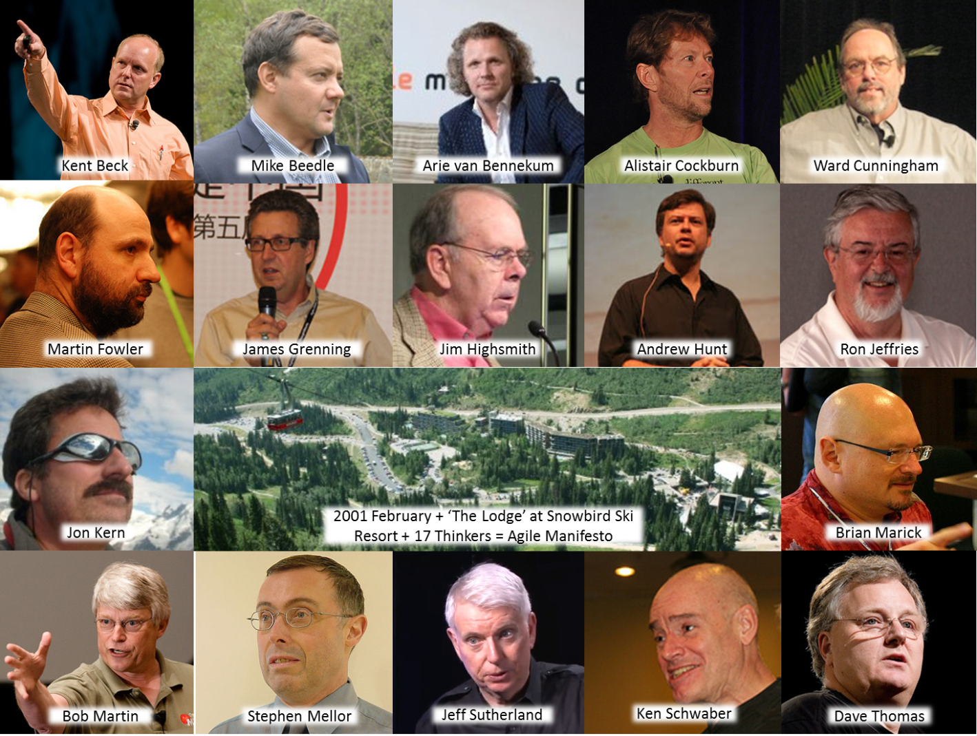
Agile Principles (cont.)
Most signatories ran consulting companies
Notes:
These are actual authors (and site!) of original Agile Manifesto

Slide 67
Agile Overview
Gather requirements
Customer: “This is what I want…”
Write & deliver code
Customer: “Okay, but it would be cool if…”
Select most important requirements from backlog
Estimate implement time so amount chosen appropriate
Write & deliver code
Customer: “This is better, but now I want…”
Repeat until customer happy

Slide 68
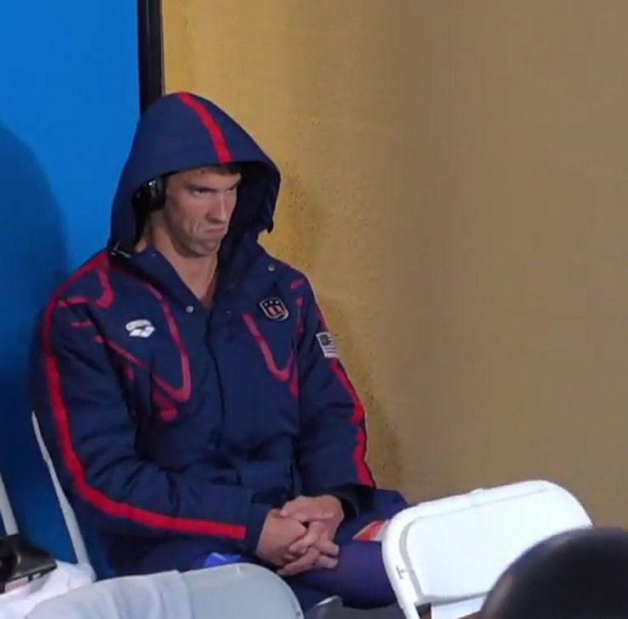
Agile Overview
Gather requirements
Customer: “This is what I want…”
Write & deliver code
Customer: “Okay, but it would be cool if…”
Select most important requirements from backlog
Estimate implement time so amount chosen appropriate
Write & deliver code
Customer: “This is better, but now I want…”
Repeat until customer happy

Slide 69
Agile Overview
Gather requirements
Customer: “This is what I want…”
Write & deliver code
Customer: “Okay, but it would be cool if…”
Select most important requirements from backlog
Estimate implement time so amount chosen appropriate
Write & deliver code
Customer: “This is better, but now I want…”
Repeat until customer happy satisfied

Slide 70
For Next Lecture
Find team of 4 or 5 students before Friday, Sept. 7
Can choose project, but team must choose & agree
Will have time in class to get chance to meet others
If needed, e-mail me by end of week & I will assign team
Website includes more project discussion & links
Most important: grading rubric used with each sprint
Resources in Baldy 19 available for groups to use
Some (older) ideas for projects your group could try

